Slide 1
MASSANUTTEN CHAPTER ARCHEOLOGICAL SOCIETY OF VIRGINIA
2014
Celebrating 35 Years

Slide 2
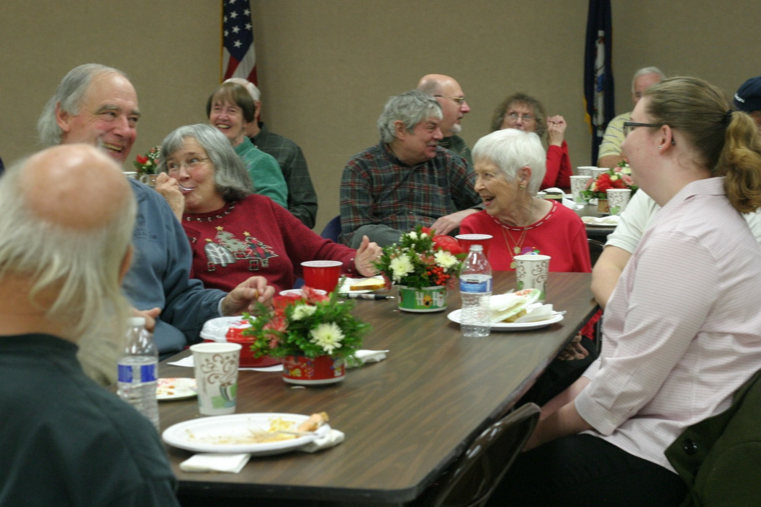
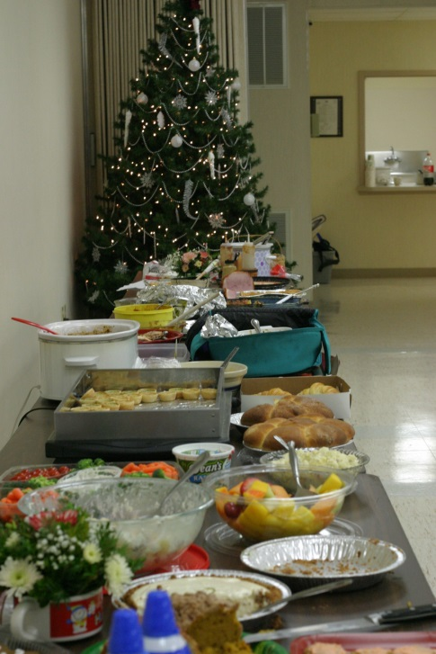
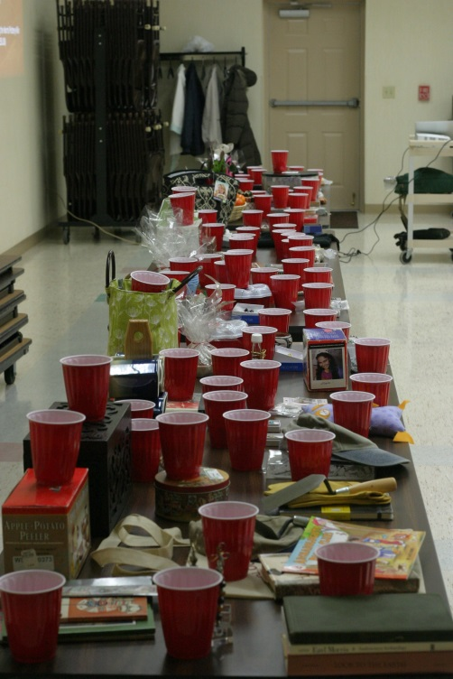
2013 Christmas Party and Auction

Slide 3
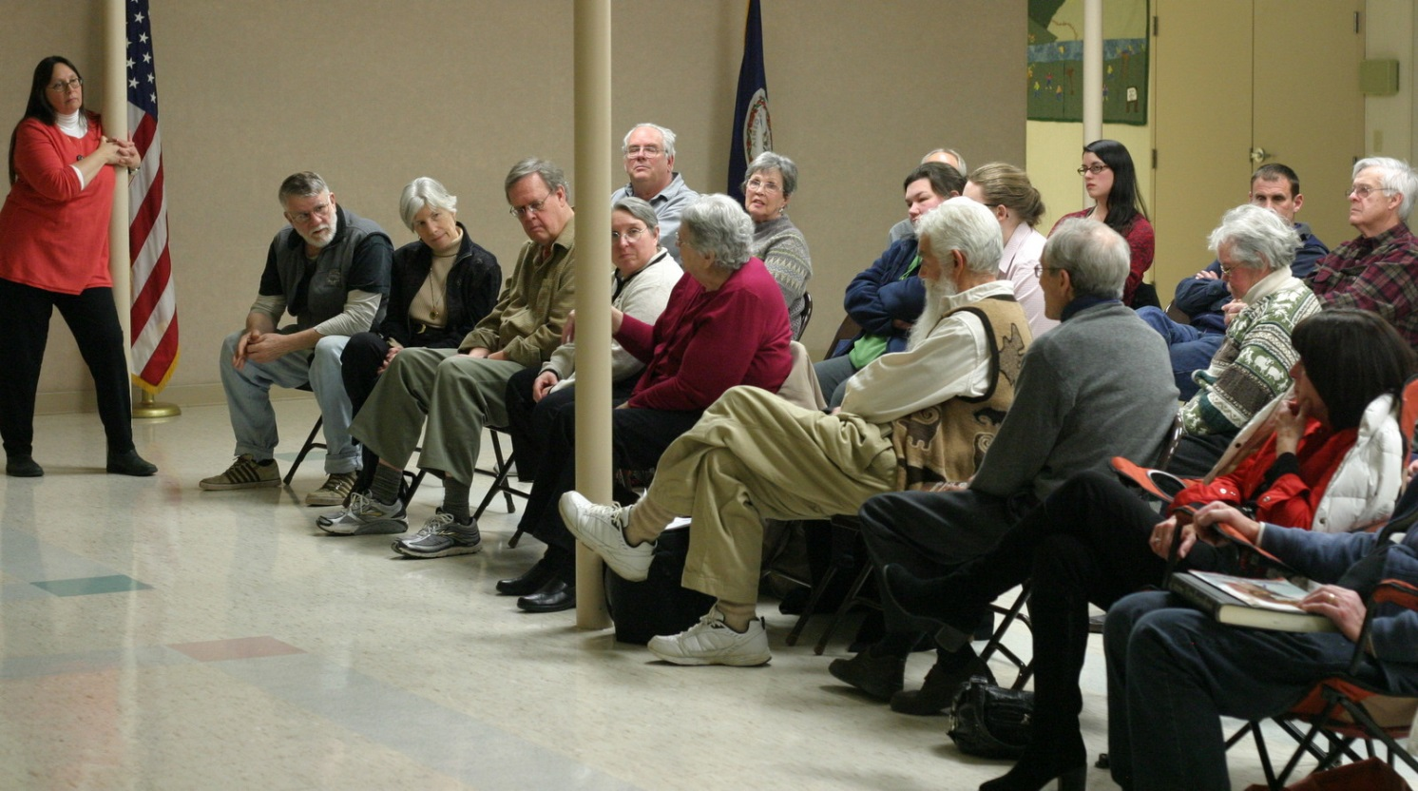
January
"An Eastern Archaeologist Visits the Southwest: True Tales from a Two-Week Jaunt" presented by Dr. Carole Nash, JMU Department of Integrated Science and Technology

Slide 4
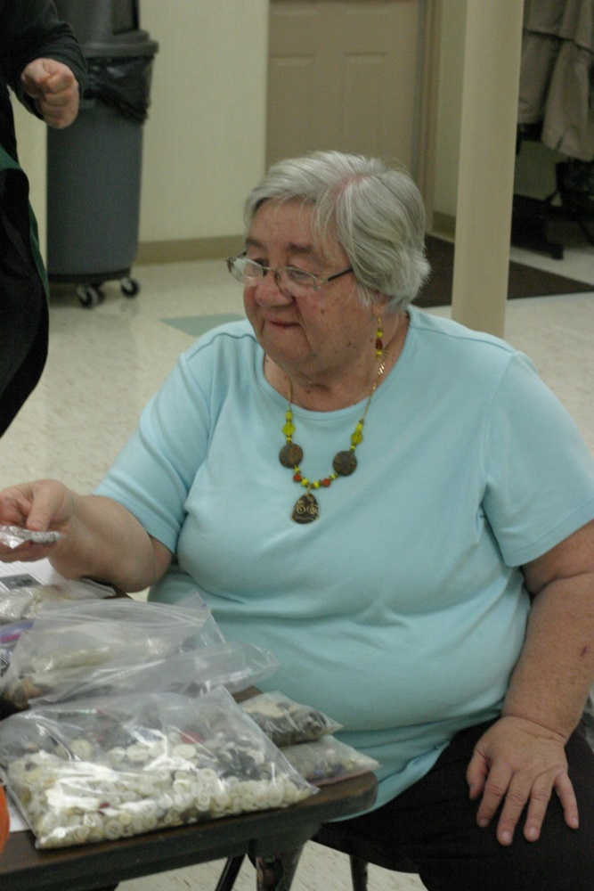
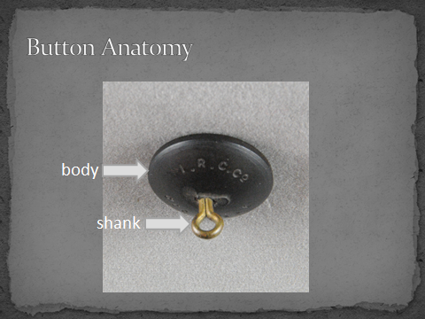
February
"Button, Button, Who's Got the Button? Learning to Identify and Date Buttons from Archaeological Contexts" presented by Janice Biller, MCASV Member

Slide 5
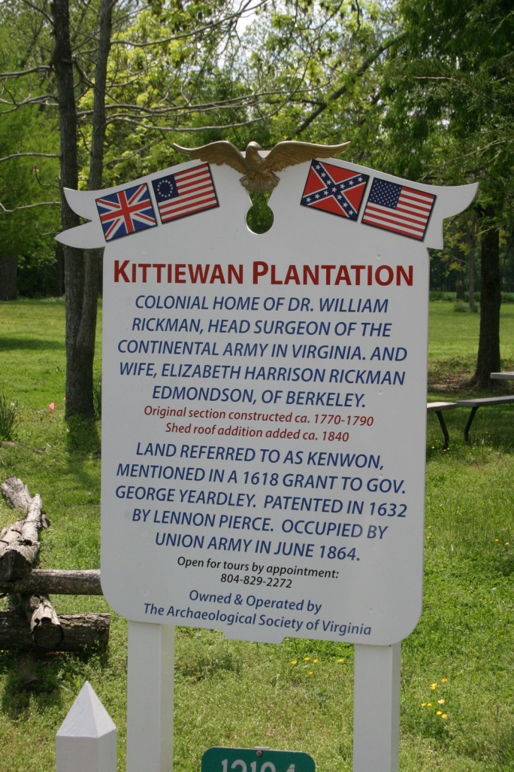
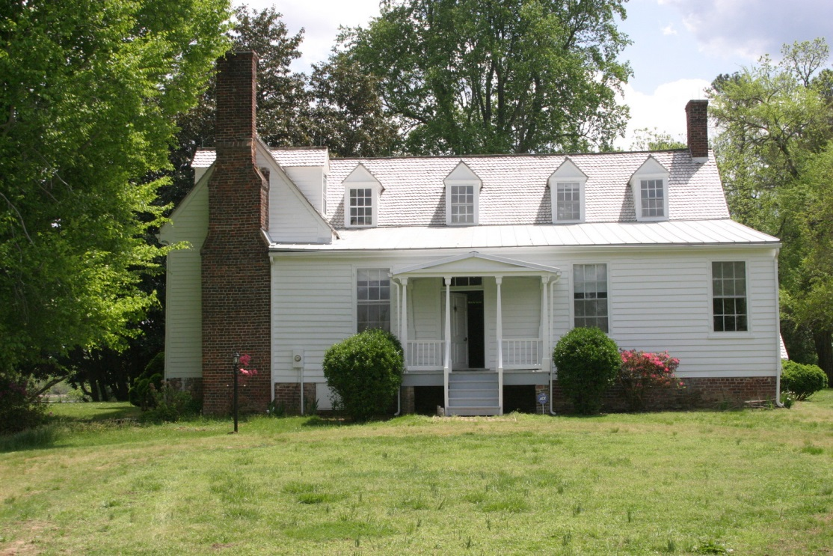
March
"Kittiewan: History, Archaeological Resources and Future Projects“ presented by Bruce Baker, ASV Kittiewan Committee

Slide 6
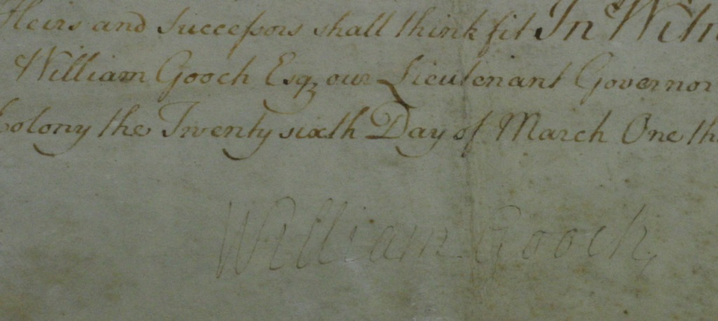
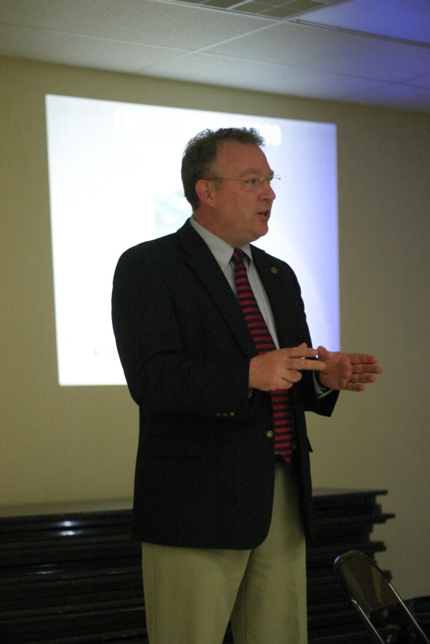
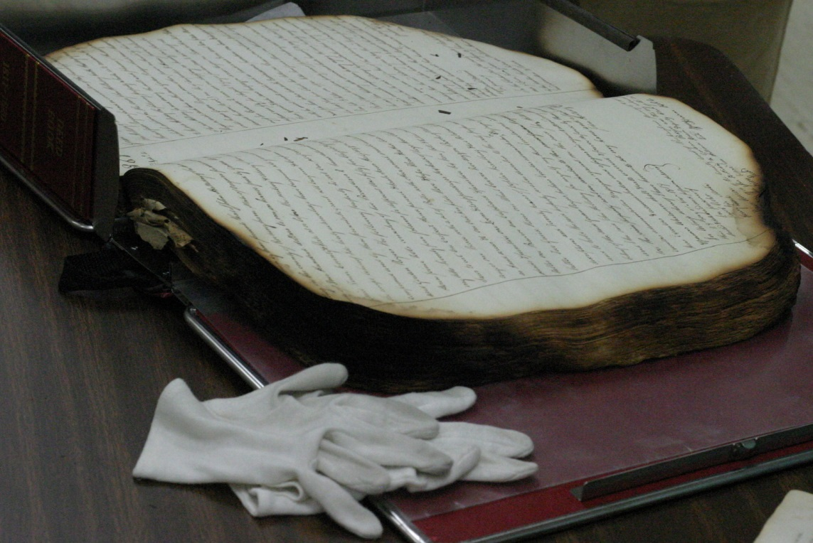
April
"Preservation of Court Records in Rockingham County", presented by Chaz Evans-Haywood, Rockingham County Clerk of Court

Slide 7
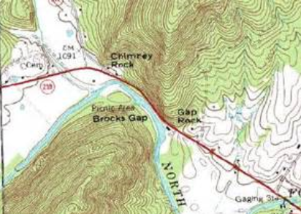
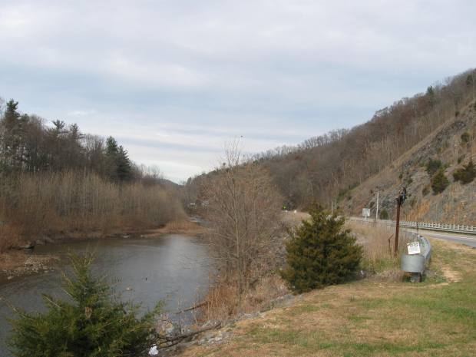
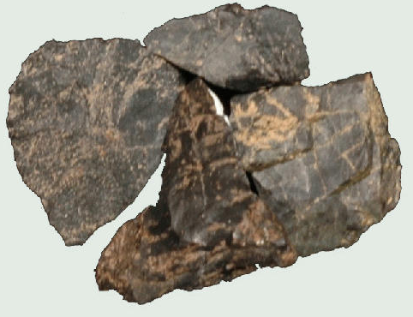
Chert Prospecting on Little North Mountain

Slide 8
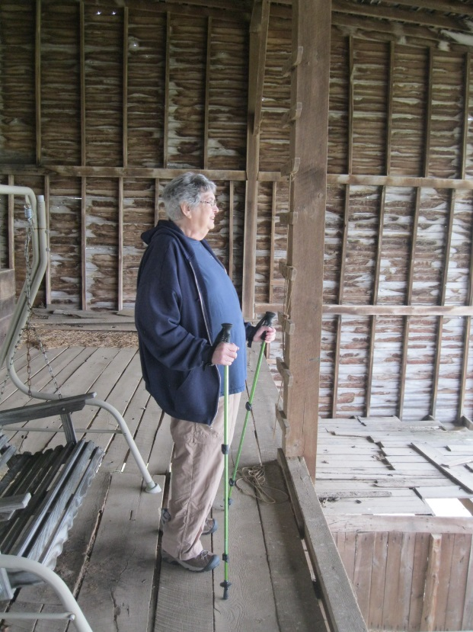
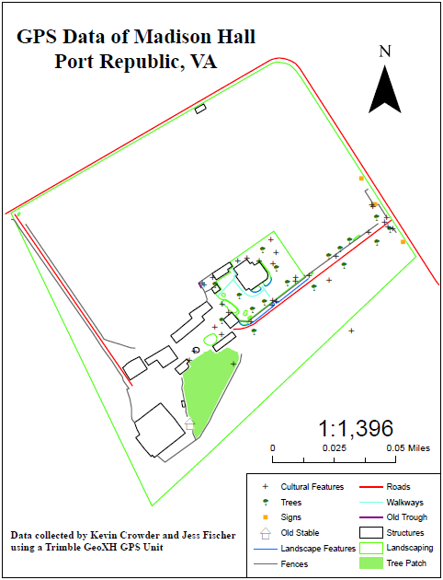
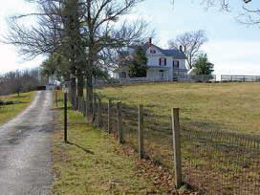
Madison Hall

Slide 9
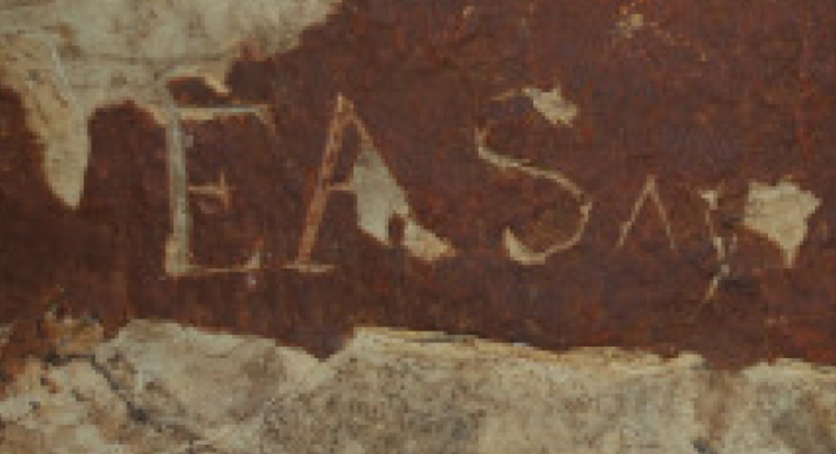
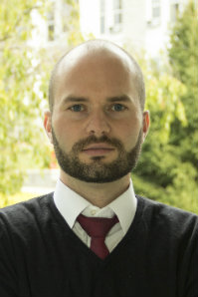
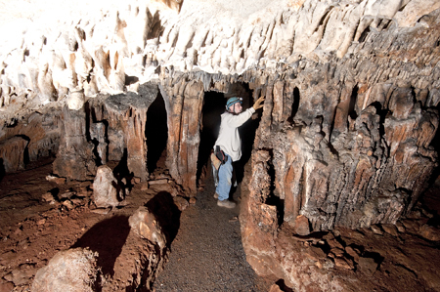
May
"Historic Cave Inscriptions in the Shenandoah Valley", presented by Dr Michael Douma,
JMU Department of History

Slide 10
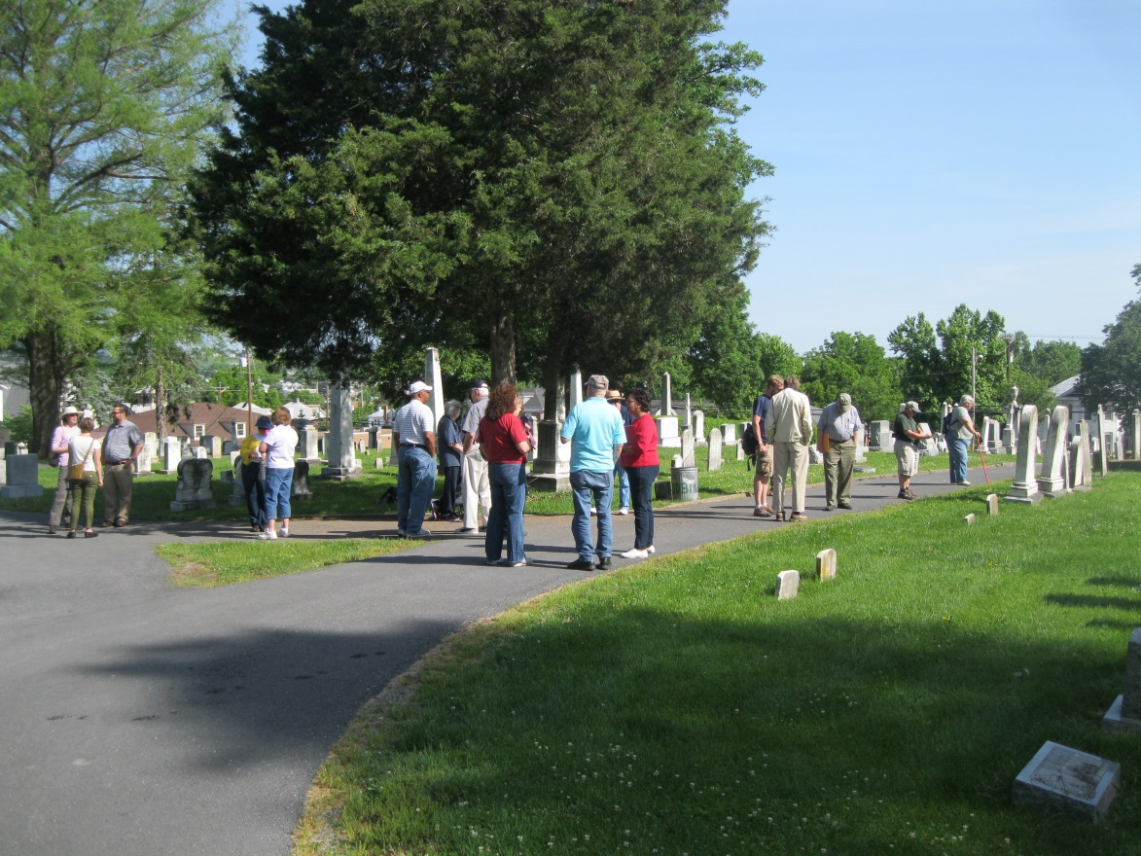
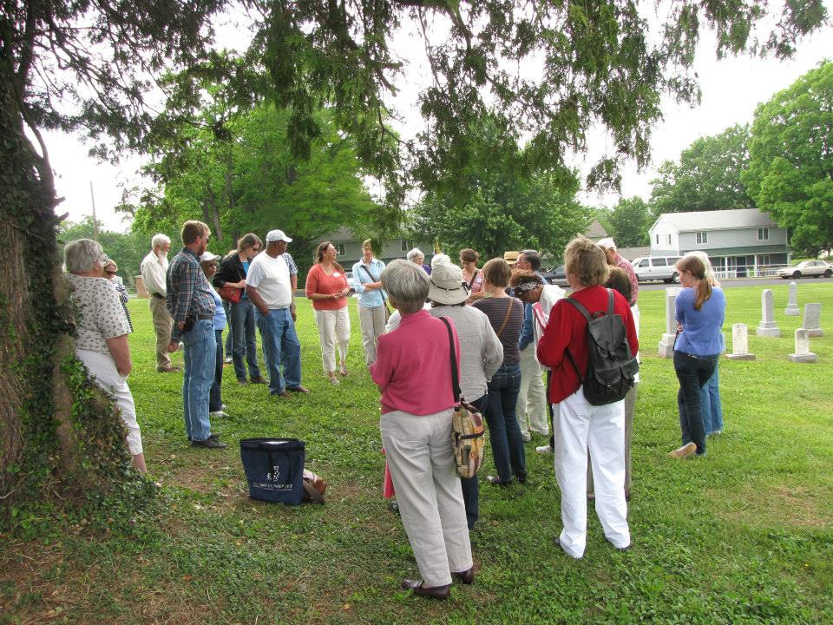
VDHR Cemetery Workshop, Harrisonburg

Slide 11
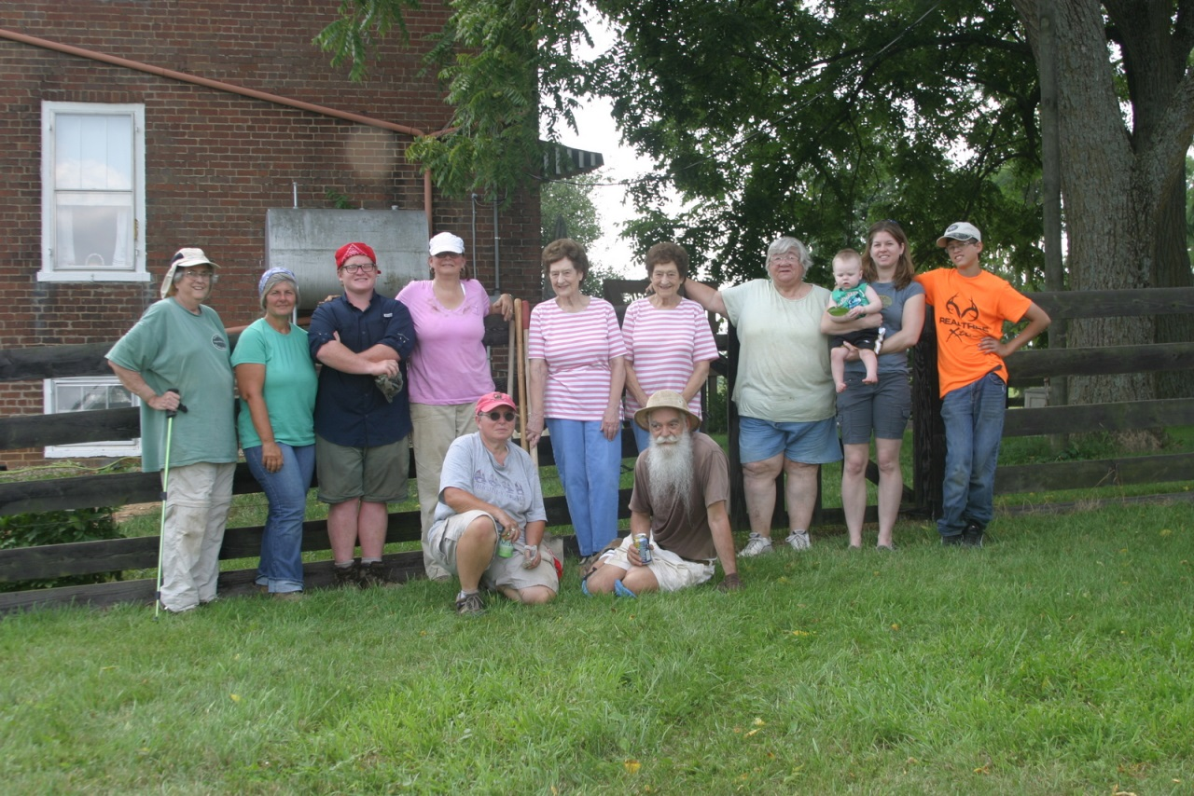
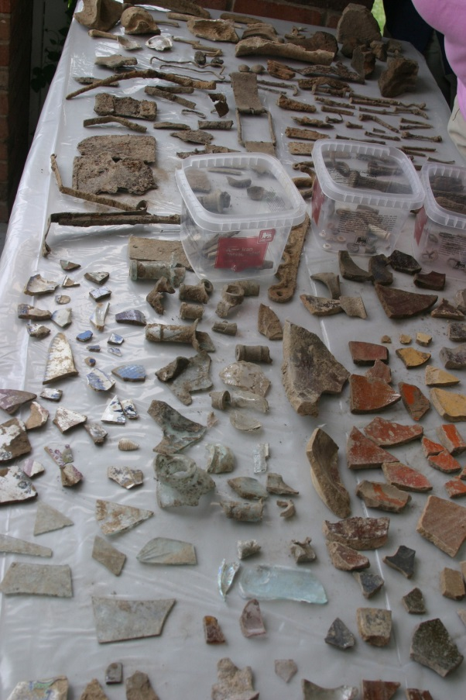
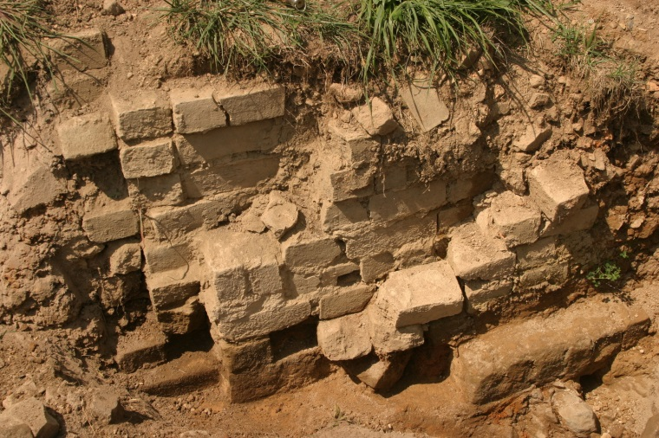
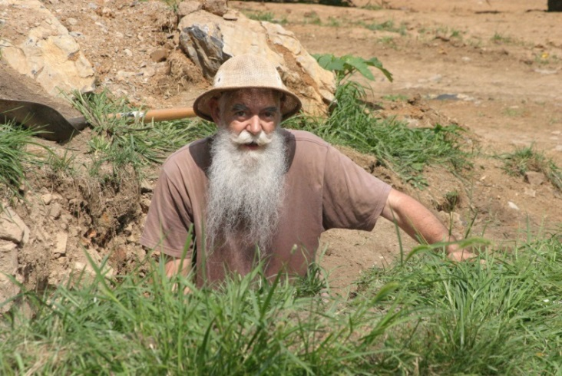
May and July: Brick Kiln (?), Zirkle House, Forestville, VA

Slide 12
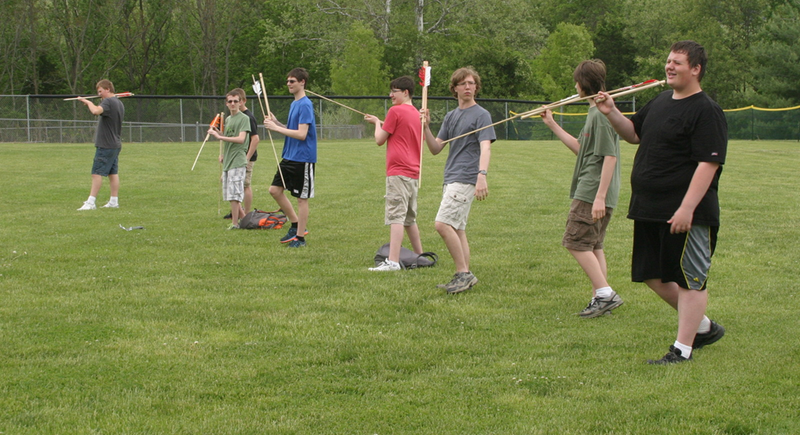
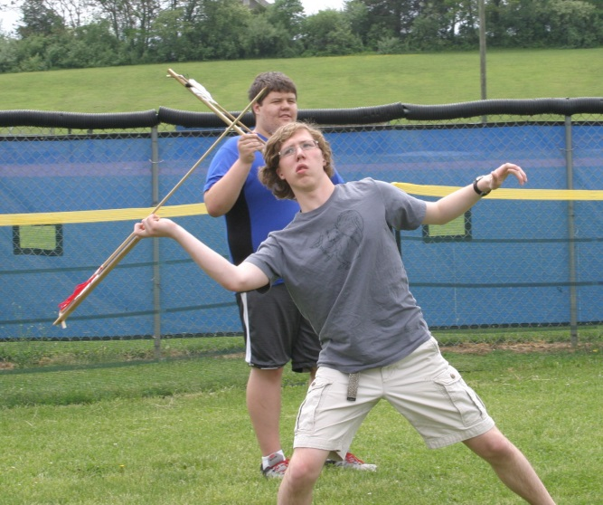
Experimental Archeology: ATLATL
Archeology Club, Fort Defiance H.S.
Sponsored by Cindy Schroer, MCASV member

Slide 13
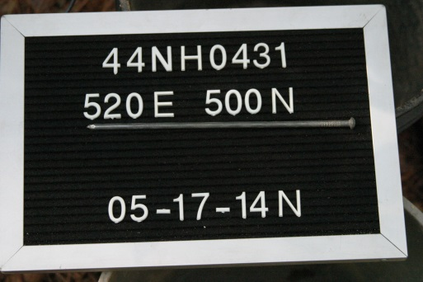
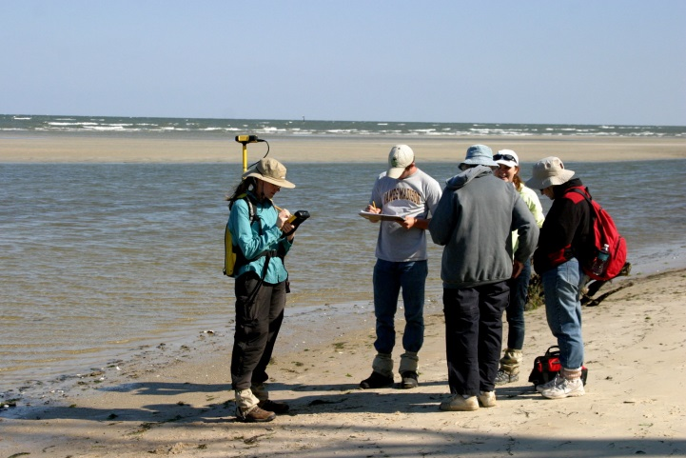
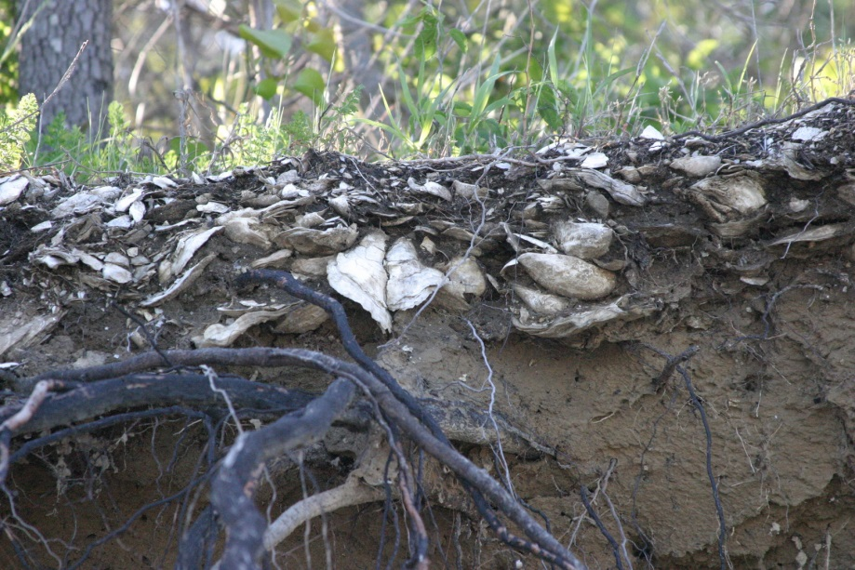
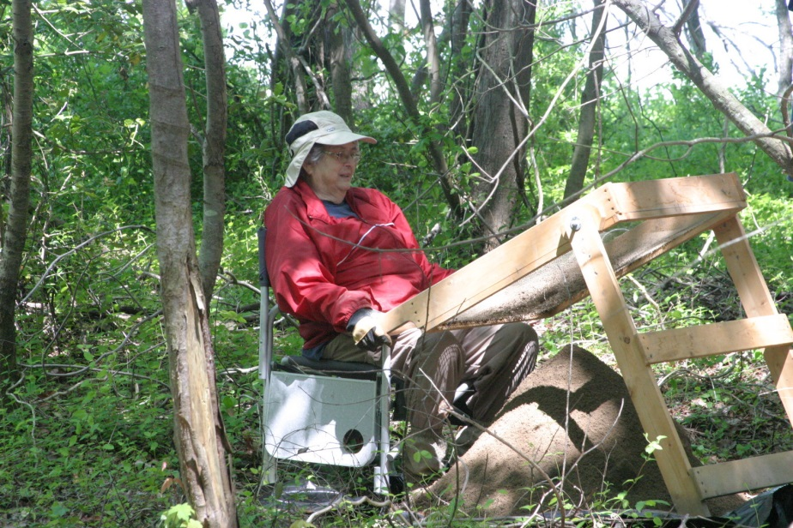
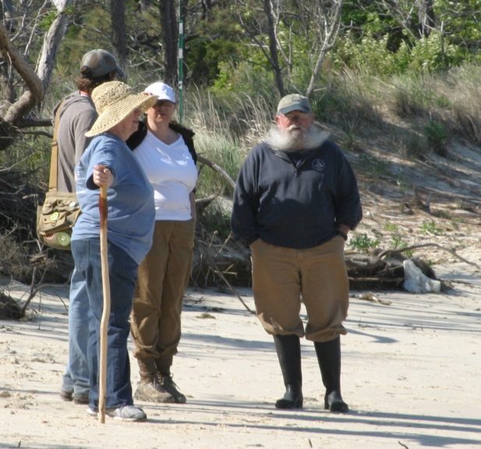
Eastern Shore Archeology

Slide 14
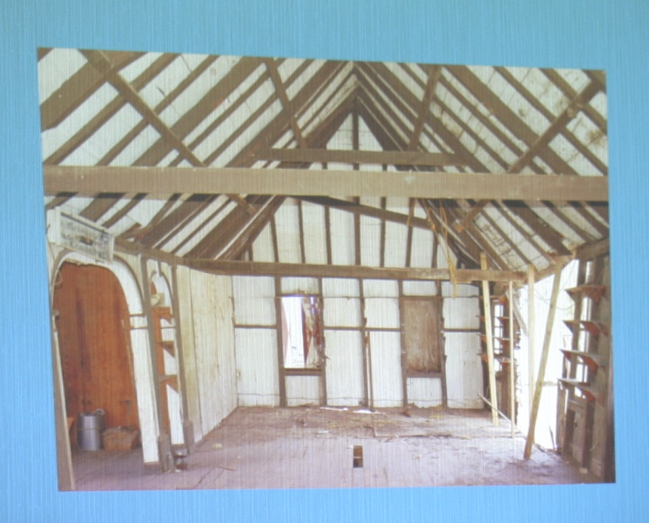
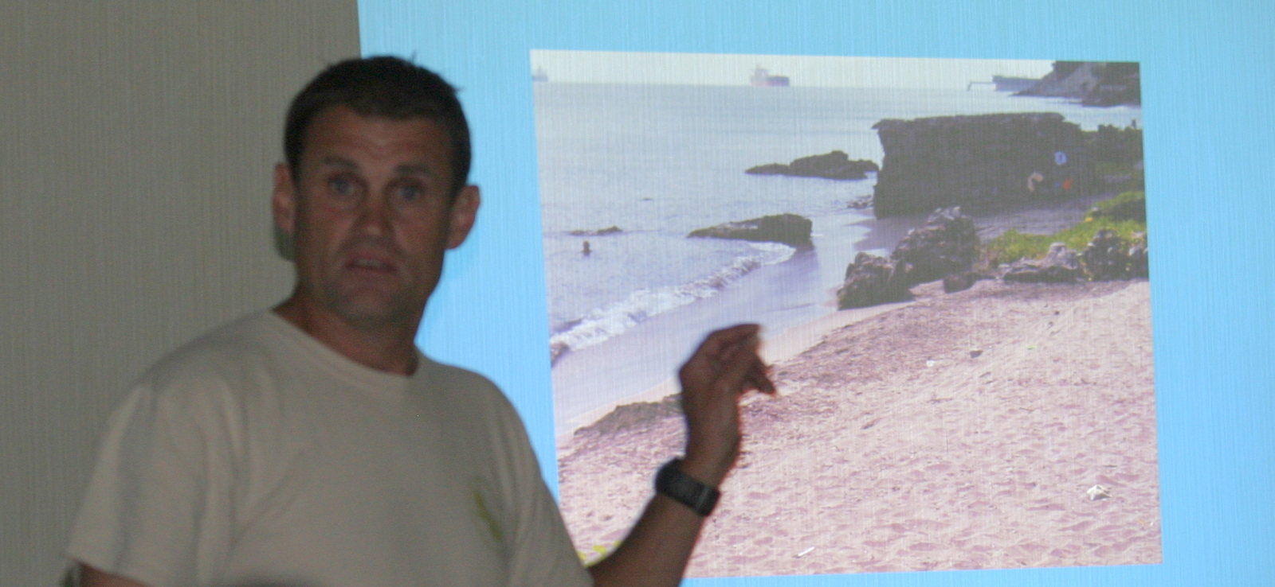
June
"The Dismantling of the Schotsenhoek Plantation House, St Eustatius", presented by Ray Wright, Frontier Culture Museum

Slide 15
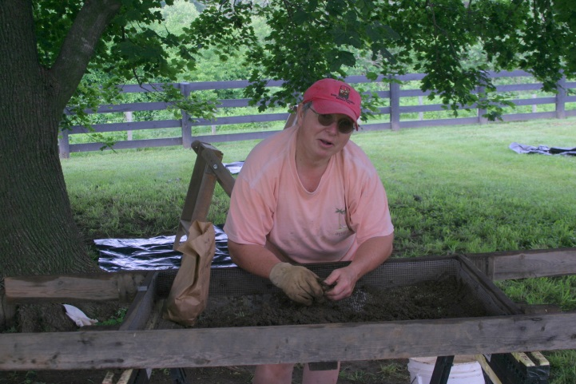
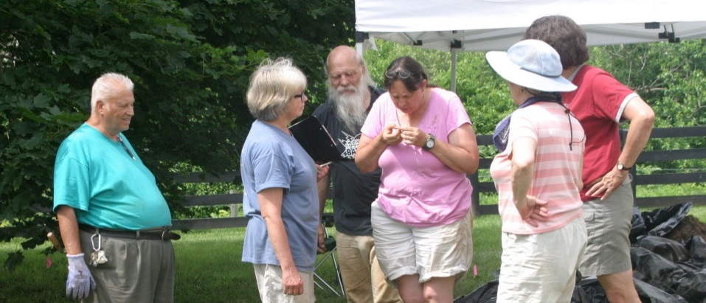
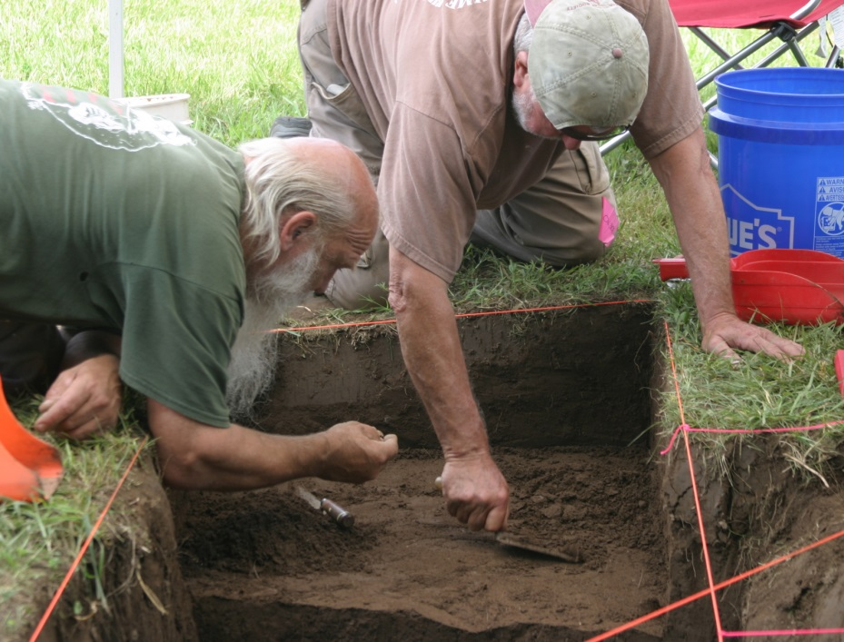
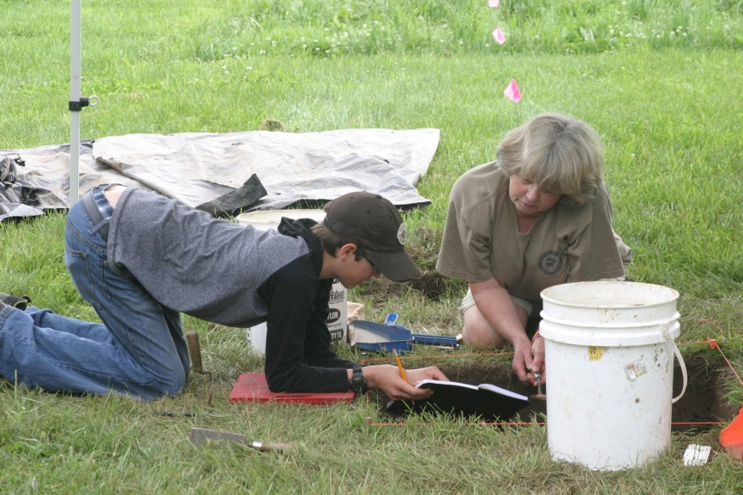
White House Farm Field School June 9-14

Slide 16
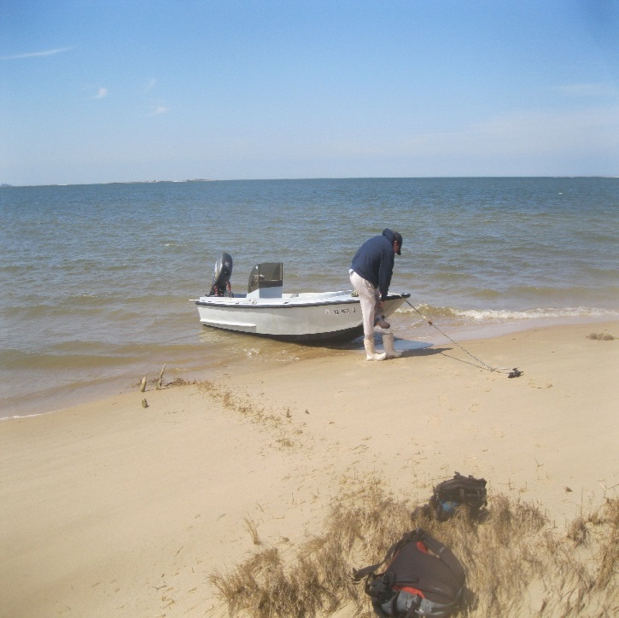
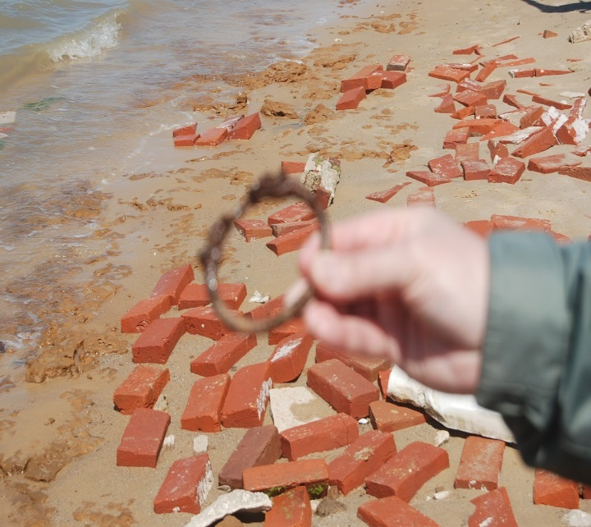
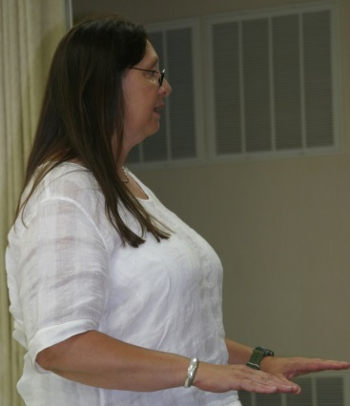
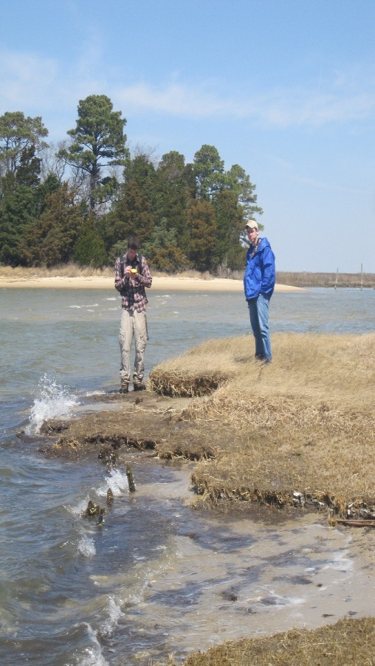
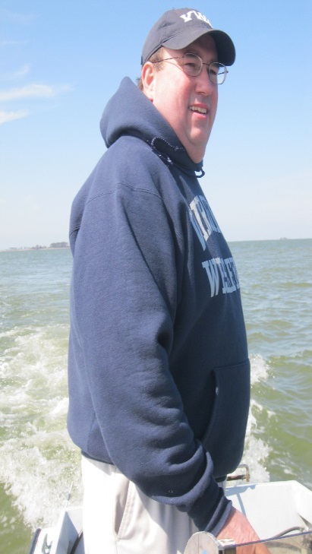
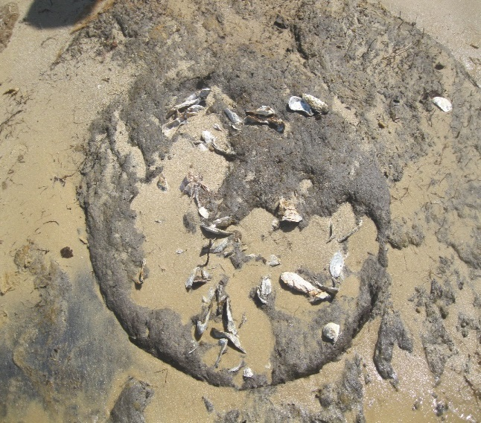
July
"Eastern Shore Archaeology", presented by Dr. Carole Nash, JMU Department of Integrated Science and Technology.

Slide 17
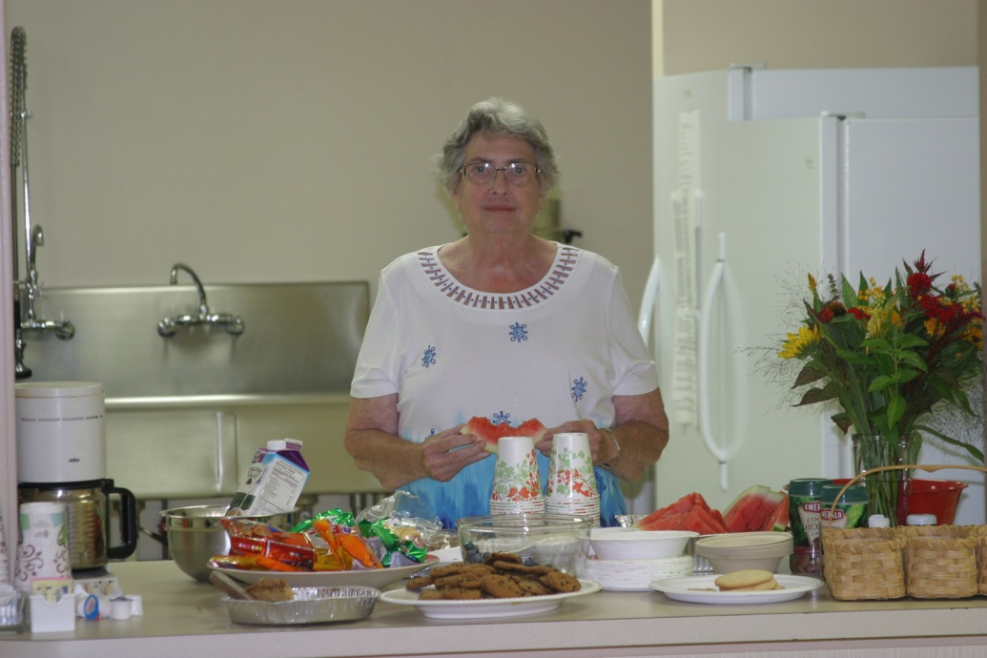
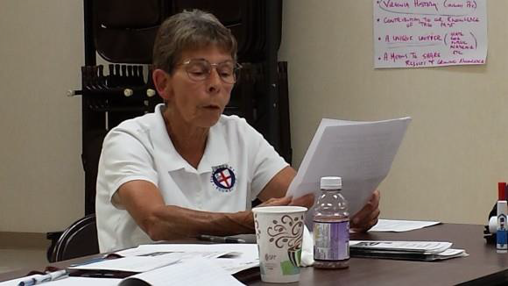
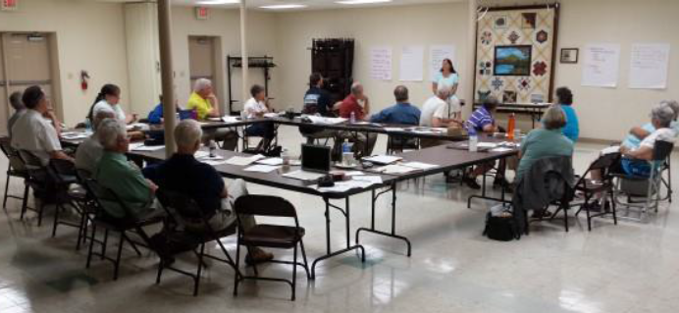
July ASV Board Meeting, Bridgewater Town Hall

Slide 18
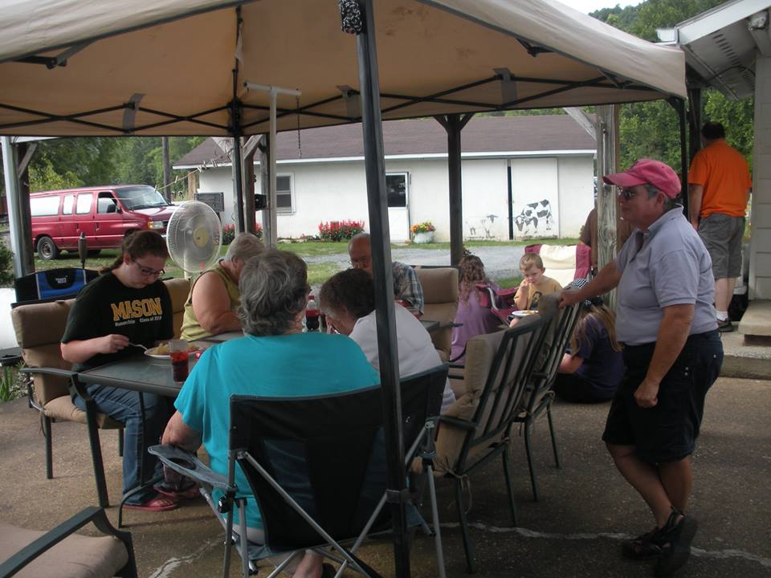
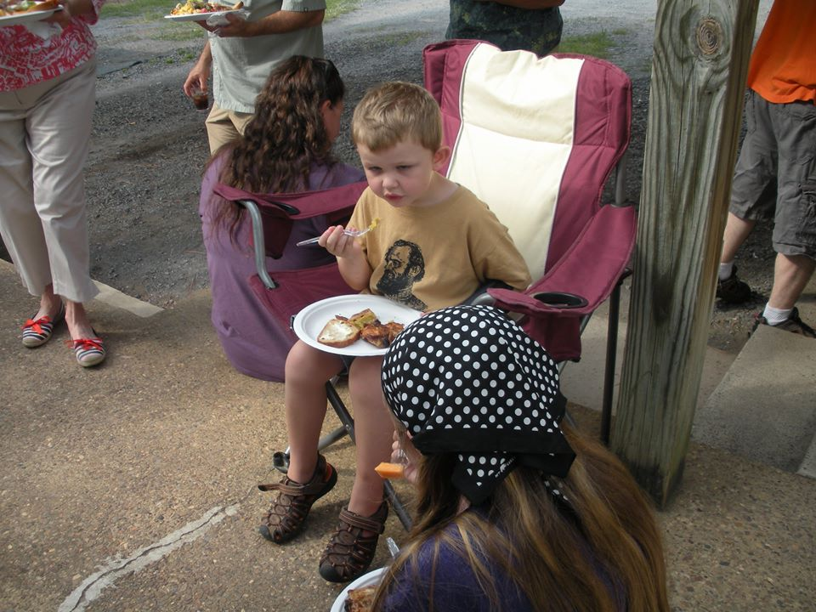

August – Annual Picnic

Slide 19






September
“What’s the Point? Point identification
presented by Cindy Schroer, MCASV member

Slide 20


October
"Archaeology at White House Farm: The 2014 Season", presented by Dr Carole Nash, JMU Department of Integrated Science and Technology.

Slide 21




November
"Archaeology at White House Farm: The 2014 Season", Part 2, presented by Dr Carole Nash, JMU Department of Integrated Science and Technology.

Slide 22
2013 Officers
Cindy Schroer, President
Carole Nash, Vice President
Kay Veith, Secretary
Tom Mizell, Treasurer
Jeff Good, Glenn Huffman, John Eckman, Newsletter Eds.

Slide 23

Monthly News-letter, Points
Articles written by members

Slide 24

See you next year!

